Slide 1


HTML
HTML Basics

Slide 2
Agenda
01
What is HTML?
02
Creating HTML Pages
03
Basic HTML Page
04
Tags and Attributes
05
06
HTML Paragraphs
HTML Headings

Slide 3
What is HTML?

Slide 4



What is HTML?
HTML Stands for HyperText Markup Language and is used to build web pages

Slide 5
What is HTML?
HTML is a markup language and not a scripting language or a programming language

Slide 6
What is HTML?
HTML is used to define the structure of the content in a web page using well defined constructs such as tags and attributes

Slide 7
Creating HTML Pages

Slide 8


Creating HTML Pages
An HTML Page is a single file that contains HTML code which can be interpreted and displayed by a web browser

Slide 9
Creating HTML Pages
An HTML file can be created using any text editor or code editor such as notepad, visual studio code etc.

Slide 10
Creating HTML Pages
In a code editor create a new file, write some HTML code and save it with a file name and ‘.html’ extension

Slide 11
Creating HTML Pages
Make sure the extension is correct otherwise the web browser will not be able to parse the file

Slide 12
Hands On: Create a blank HTML Page

Slide 13
Basic HTML Page

Slide 14
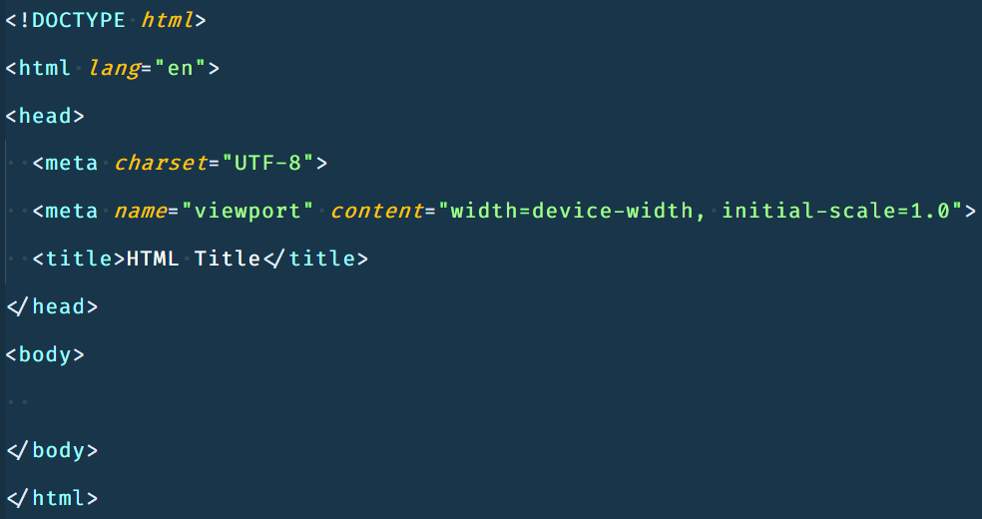
Basic HTML Page
To write an HTML page you first need to understand the basic structure of an HTML page. The code below shows a basic HTML page

Slide 15
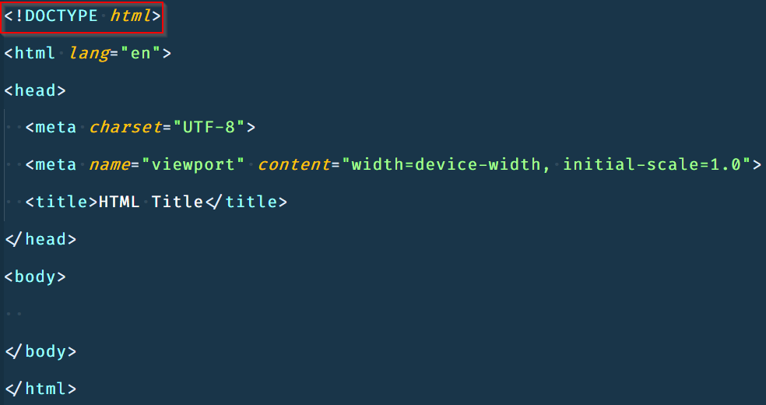
Basic HTML Page
In the first line we have doctype declaration which tells the browser what document type to expect

Slide 16
Basic HTML Page
There are several DocTypes available in HTML the one used below is to HTML 5

Slide 17
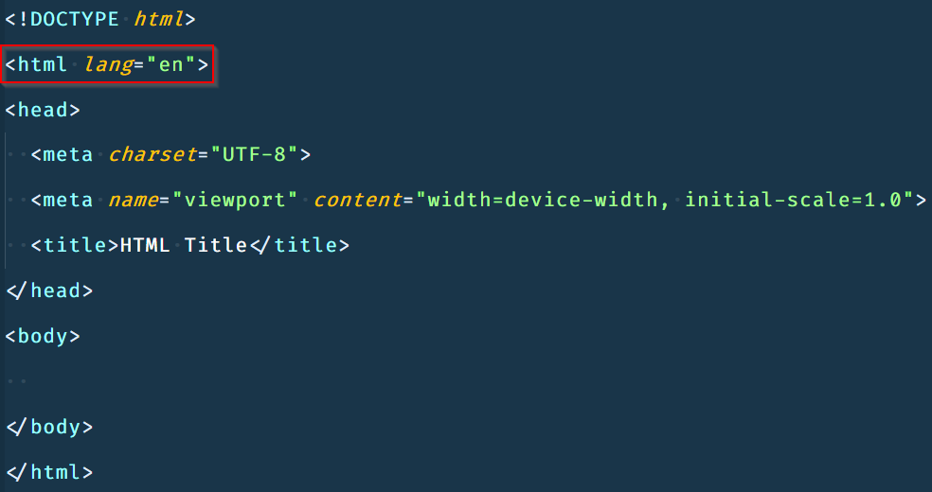
Basic HTML Page
Then, we have the root HTML tag. The code we write needs to be between the opening and closing HTML tag for the browser to understand

Slide 18
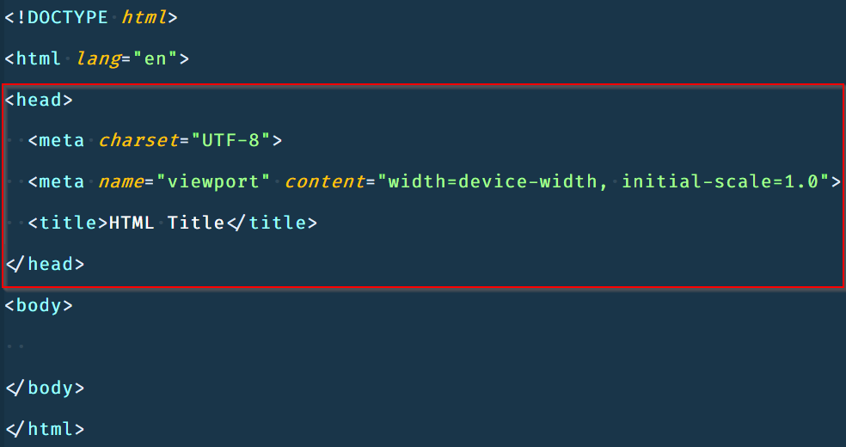
Basic HTML Page
The Head tag contains information about the HTML page we are writing

Slide 19
Basic HTML Page
The head tag in our example contains information about character set, viewport and the title of the web page which appears on the browser tab

Slide 20
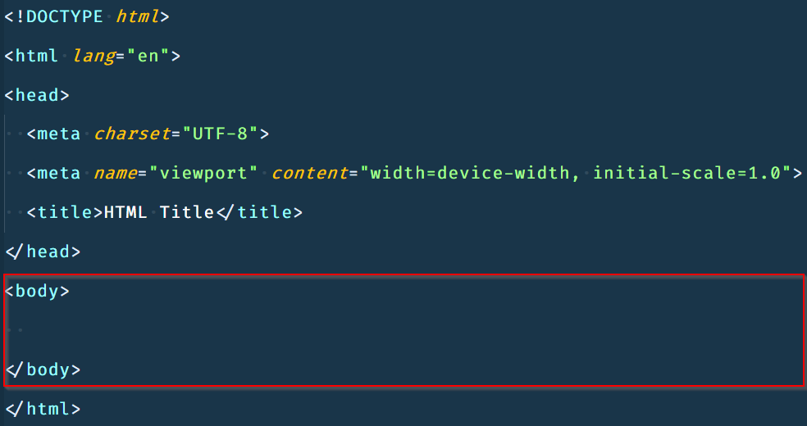
Basic HTML Page
The body tag will contain all the code that we wish to display things on the webpage

Slide 21
Basic HTML Page
When building an HTML page we will write majority of our code inside the body tags

Slide 22
Hands On: Basic HTML Page

Slide 23
Tags and Attributes

Slide 24
Tags and Attributes
Tags and attributes are the fundamental building blocks of an HTML page
HTML Tags
HTML Attributes

Slide 25
Tags and Attributes
Everything we do in HTML is done using tags and attributes as these are the things that a browser understands and uses to display content on a webpage
HTML Tags
HTML Attributes

Slide 26
Tags and Attributes
An HTML Tag is wrapped inside opening and closing angle brackets (<>)
HTML Tags
HTML Attributes

Slide 27
Tags and Attributes
An HTML Tag can contain an HTML element which in turn contains the content which we wish to display on the screen
HTML Tags
HTML Attributes

Slide 28
Tags and Attributes
Between the opening and closing tag we can add HTML elements or nest other tags as well
HTML Tags
HTML Attributes

Slide 29
Tags and Attributes
On the other hand, HTML attributes are used to describe the characteristic of an HTML element in detail
HTML Tags
HTML Attributes

Slide 30
Tags and Attributes
Attributes are always specified in the start tag and never in the end tag
HTML Tags
HTML Attributes

Slide 31
Tags and Attributes
Attributes usually appear in name-value pairs like: name=“value”
HTML Tags
HTML Attributes

Slide 32
Tags and Attributes
Different HTML elements may have different HTML attributes which you can use in order manipulate their behavior
HTML Tags
HTML Attributes

Slide 33
Hands On: Tags and Attributes

Slide 34
HTML Headings

Slide 35
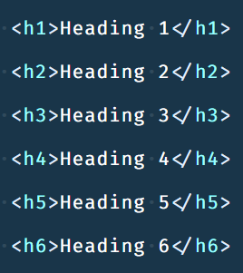
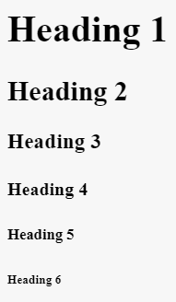
HTML Headings
In HTML we use heading tags to tell a web browser that the text that is inside this tag is to be displayed as a heading

Slide 36
HTML Headings
In HTML there are six tags that define headings there are: h1, h2, h3, h4, h5 and h6

Slide 37
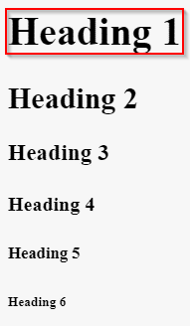
HTML Headings
H1 defines the most important heading such as the title of blog or headline of new report

Slide 38
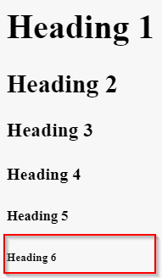
HTML Headings
H6 defines the least important heading such as a post script or a note to the reader etc.

Slide 39

HTML Headings
Headings are very important as search engines use headings to better understand the content of your page

Slide 40
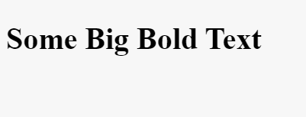


HTML Headings
Make sure you use HTML headings only for your headings and not or displaying text as big and bold

Slide 41
Hands On: HTML Headings

Slide 42
HTML Paragraphs

Slide 43
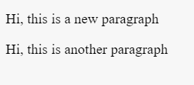
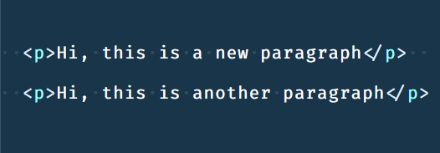
HTML Paragraphs
In HTML a paragraph is displayed as a block of text that starts on a new line

Slide 44
HTML Paragraphs
We create a paragraph using <p> tag and the text inside opening and closing p tag is displayed as a paragraph

Slide 45
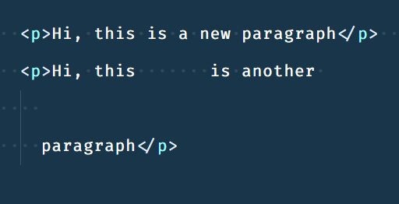
HTML Paragraphs
When using HTML paragraphs, we cannot change how the browser will display the content display by adding extra spaces or extra lines in the HTML code

Slide 46
HTML Paragraphs
The browser removes any extra spaces and lines it finds in text which is contained in almost any HTML tag

Slide 47
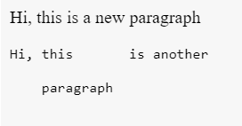
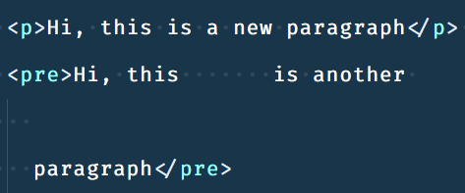
HTML Paragraphs
If you wish to display text formatted using spaces and new lines then you can make use of the pre tag

Slide 48
Hands On: HTML Paragraphs

Slide 49


India: +91-7847955955
US: 1-800-216-8930 (TOLL FREE)
support@intellipaat.com
24/7 Chat with Our Course Advisor
Notes:
Thank you!

